Slide 1

DriverPass System Analysis
Brianna Reed
Notes:
today I will walk you through the new DriverPass system we have designed for your driving school
You will see how each piece, from booking lessons to getting up to date DMV info all comes together in a simple intuitive package that keeps students, secretaries, instructors, and administrators in sync!!
Let’s dive in!!!

Slide 2

System Requirements
Functional:
Self service lesson management: Students can register, book, modify, or cancel driving lessons online in just a few clicks without calling your office
Automatic DMV updates: Whenever the state publishes new test rules or questions, our system ingests them so practice quizzes always reflect the latest standards Nonfunctional:
Fast performance: Pages and calendars load in under 2 seconds, so nobody ever waits around
Robust security: All personal data and payment transactions use industry standard encryption, and daily backups ensure nothing ever gets lost
Notes:
Self service lesson management means your staff spends less time on the phone and more time helping students learn
Automatic DMV updates keep your content fresh and compliant without any manual edits
With fast performance, students breeze through booking even on slower connections so they stay engaged rather than frustrated
And robust security wraps every click and credit card charge in encryption, plus routine backups, so you and your students can trust the system completely

Slide 3
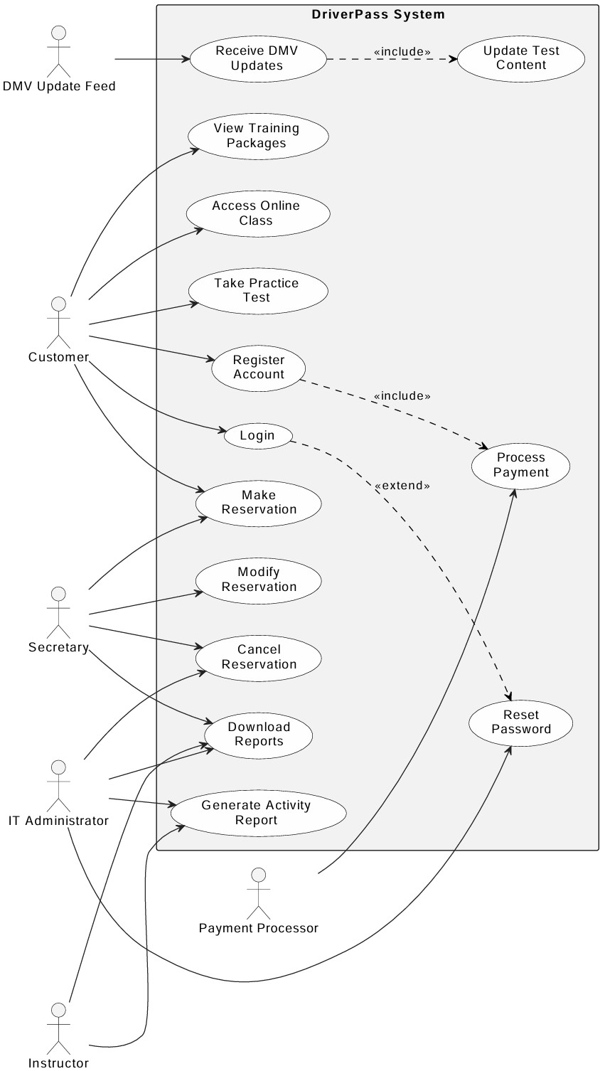
Use Case Diagram
Notes:
This diagram shows who does what
Students can register, log in, browse packages, book or cancel lessons, and take practice tests
Secretaries manage and modify reservations or pull reports
Instructors can review their lesson schedules
IT Administrators oversee system health and generate activity logs
A DMV feed actor automatically updates test content
This map made sure we covered every feature you asked for no surprises

Slide 4
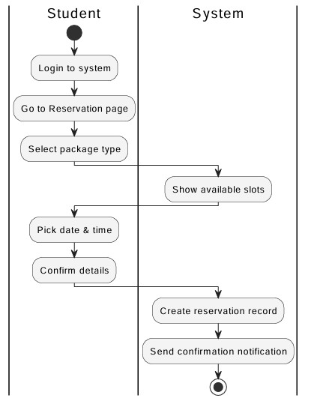
Activity Diagram
Notes:
the student’s journey when booking a lesson:
Login or Register if they are new
Select a training package
Pick a date and time from the live calendar
Confirm their reservation in two clicks
Receive instant onscreen confirmation and an email
sketching it out step by step ensures the flow is intuitive no confusing screens or dead ends so students can reserve lessons in under a minute

Slide 5
Security
All data in transit encrypted via HTTPS/TLS
Strong password policy with optional two factor authentication
Role based access controls (Customer, Secretary, Instructor, IT Admin)
Account lockout after five failed login attempts and audit notifications
Notes:
Security was top of mind the whole time
Every click and form is wrapped in industry standard encryption
We never store raw passwords, and you can turn on two factor authentication for extra peace of mind
By assigning each user a role (student, secretary, instructor, or admin) we prevent accidental access to sensitive data
And because we run daily backups and keep an audit trail, you can restore lost data and review who did what, when

Slide 6
System Limitations
Requires an internet connection.. no offline mode
No native mobile app; users access via browser only
DMV updates depend on the state’s feed schedule
Custom feature changes require a developer deployment
Notes:
To set clear expectations, here are the system’s boundaries
Everything runs in a browser, so it won’t work offline or as a phone app
Our DMV content updates as soon as the state publishes new data but if their feed is delayed, ours will be too
Finally, while most settings can be tweaked in the admin console, adding brand new features will need a quick code update from your development team

